Slide 1
Credit Card Default – Use Case Slides
Elena Lowery, IBM Analytics Architect

Slide 2
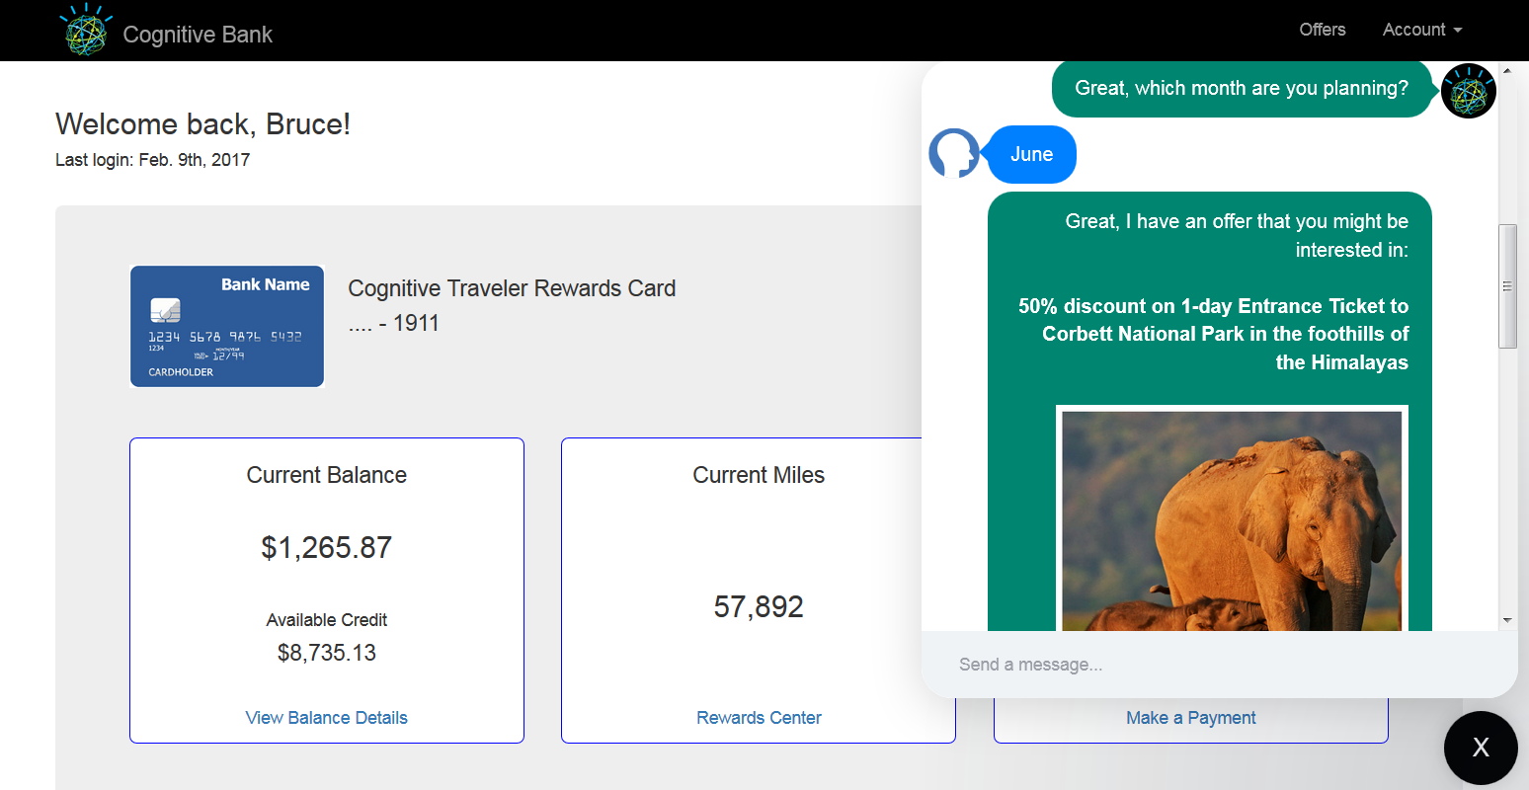
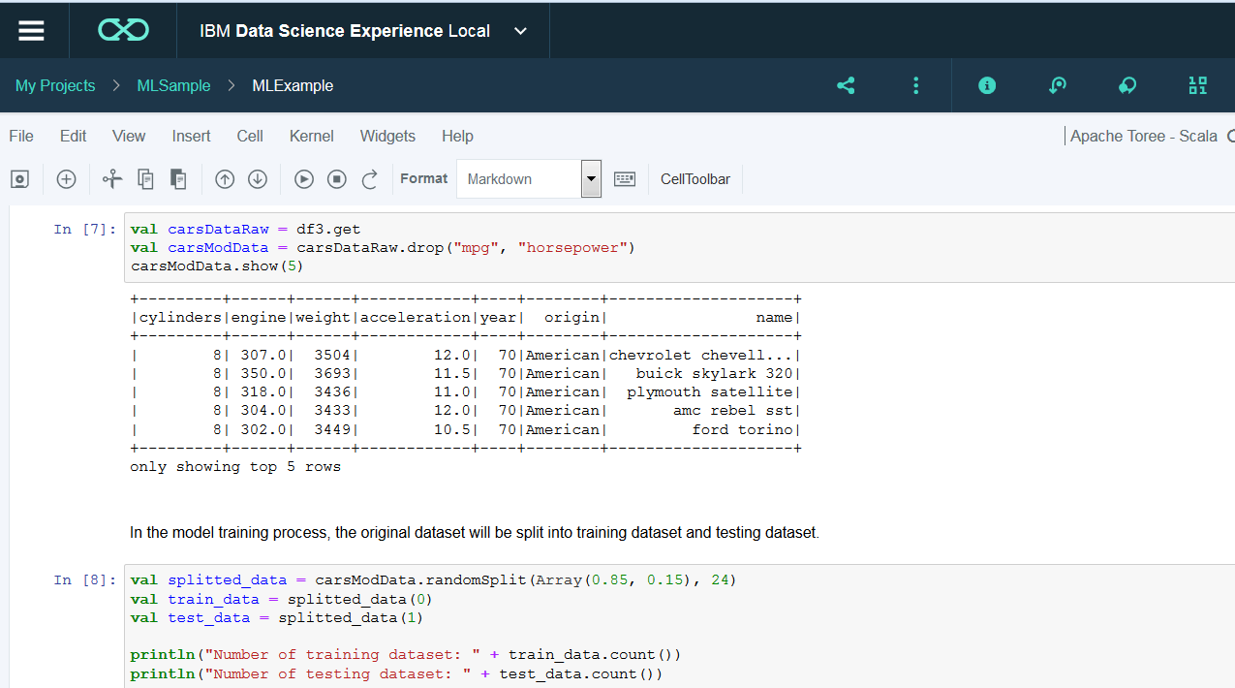
Demo use case: Credit Card Default
In our demo we’ll show how to use analytics to predict credit card default
A client approved many low value merchant accounts without much scrutiny. Many of those merchant accounts resulted in default. The client thinks that they should have put more of an emphasis on their applicant screening process
Goals
Understand profiles of merchants who have defaulted on their credit cards and share it with the acquisitions, marketing, and customer care teams
Create a predictive model for credit card default
The model can be deployed for batch or real time scoring
Batch scoring – provide scoring results to the marketing and acquisitions team
Real time scoring – real time offers on Webpage, Call center application
Real time analytics
Notes:
In our demo we will show how you can implement real time analytics to predict customer churn in Data Science Experience. Customer churn is not always predicted in real time, the deployment option depends on the type of data we are using to predict churn, but for our demo let’s assume that we want to integrate analytics with the Call Center application.
We are assuming that we are collecting some data in real time and therefore we will deploy the model that we create for real time scoring.

Slide 3
Implementation steps
In DSX
Build credit card default predictive model using historical data
Save the model in the repository
Deploy and test the model
Call Center application
Implement REST Client
Notes:
The implementation steps in DSX are
Data understanding: create a data visualization notebook
Build the model using historical data
Save the model in the repository
Deploy and test the model
These are the steps that I will show in the demo.
The final step, implementing a REST client application is outside of DSX. It’s a simple programming tasks that all developers are familiar with, so we will not focus on it in the demo.

